Slide 1

SSD Collaboration
Independent Evaluation of Home Care Client Management Systems (CMS)

Slide 2
What the project will deliver?
A comprehensive resource that independently evaluates and compares 14 Home Care CMS vendors in market. The
resource will include:
comparison table
Rankings on all key functionalities and noting where products have clear deficits
Identified innovative features of each CMS
Strengths and weaknesses of each product (from demonstrations and reference checking)
Individual report of results on each CMS vendor including reference checks, due diligence, pricing methodology, and
project implementation approaches, pre and post-implement support.
Contact Details and company information on each of the vendors.
Why?
To support small – medium CHSP/Home Care providers who do/may not have in-house ITC capability and know-how.
Reducing the cost of vendor selection. Some CHSP providers could not afford to engage consultants individually to do this level of evaluation and due diligence.
60% of home care providers surveyed in April 2023 (380 respondents) stated current CMS is not fit for purpose or is non-existent. Their need to implement a system but not sure where to start.
To reduce buyers regret by giving providers an independent view of platforms in market
Helps CHSP providers to short list for their own due diligence and selection

Slide 3



The goal is to have the background research done for them and reduce buyers regret
73% of tech purchasers who have bought but not implemented their products/solutions indicated high regret.
56% of the purchases studied were categorised as high regret.
Only 13% of the purchases were categorised as no-regret

Slide 4


GOAL TO SHORT LIST 10 VENDORS FOR DEEP DIVE, DUE DILIGENCE, DEMOS, REFERENCES
Alaya Care / Procura Alchemy Technology Brevity Care Vision Civica – Carelink E-Tools Health Metric Humanix IPM Lumary | Nightingale Polixen Sandwai Shiftcare The lookout way Traccs (adamas) Turnpoint Uniti Visicase Visual Care

Slide 5


Hayylo
Care Page
CareSmartz360
Checked In Care
Conpago
GoldCare
CareApp
Telltouch
GOAL TO SHORT LIST TO 4 VENDORS FOR DEEP DIVE, DUE DILIGENCE, DEMOS, REFERENCES

Slide 6
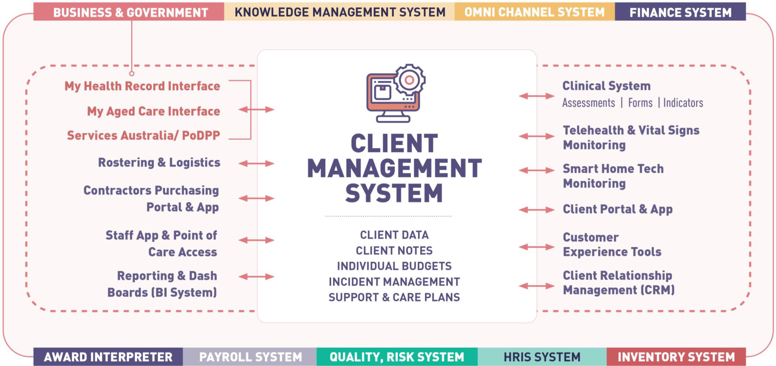

Slide 7

































































































































• • • • • • • • • • • • • | • • • • • • • • • • • • • | • • • • • • • • • | • • • • • • • • • • • • | • • • • • • • • • • | • • • • • • • • • | • • • • • • • • • • • | • • • • • • • • • •

Slide 8



































































































